Slide 1

Privacy-Preserving Deep Learning
Paper Written By: Reza Shokri, Vitaly Shmatikov
shokri@cs.utexas.edu, shmat@cs.cornell.edu
Presentation Created By: Jordan Grewe
gp0569@wayne.edu

Slide 2
Preview- Collaborative Learning Without Data Sharing
New system enables multiple participants to train models on their data without sharing it.
Innovation: Selective Sharing of model parameters during training.
Utilizes stochastic gradient descent (SGD) to update parameters asynchronously.
Effective in avoiding local optima and improving model accuracy without data exposure.
Tunable balance between privacy and accuracy.

Slide 3
The Power and Risk of Deep Learning
Companies such as Google, Facebook, and Apple leverage huge amounts of user data to train neural networks.
Users benefit from new services, such as powerful image search, voice-activated personal assistants, and machine translation of webpages in foreign languages.
But the underlying models constructed from their collective data remain proprietary to the companies that created them.

Slide 4
Why Privacy Matters in Deep Learning
Centralized data collection creates privacy risks.
Data like photos, voice recordings, and videos are stored indefinitely, often without user control.
Collected data is vulnerable to subpoenas and surveillance, and models trained on it remain proprietary.
In fields like medicine, strict data sharing laws reduce model effectiveness due to smaller, homogeneous datasets.

Slide 5
Privacy in Deep Learning
Traditional approaches like Secure Multi-Party Computation (SMC) focus on protecting computation steps but have performance overheads.
Privacy-preserving techniques for conventional models (Naive Bayes, decision trees) do not address collaborative deep learning.
Differential privacy and SMC have limitations in neural network training.
Aggregating neural network parameters doesn't necessarily lead to better models.

Slide 6
What is Deep Learning?
Deep learning is the process of learning nonlinear features and functions from complex data.
Outperforms traditional methods in areas such as speech, image, and face recognition.
Breakthrough in image recognition claimed to surpass human performance (ImageNet dataset).
Used in analyzing sensitive biomedical data, like cancer and genetics, raising privacy concerns.

Slide 7
How Does Deep Learning Work?
Input Data: Deep learning starts with high-dimensional data (e.g., images, text).
Multi-layer Neural Network: Data is passed through a multi-layer network, where each layer computes abstract features (e.g., edges, shapes in images).
Neurons & Weighted Inputs: Each neuron computes a weighted sum of its inputs and applies an activation function (e.g., ReLU, sigmoid) to produce an output.
Feed-Forward Propagation: The data flows from the input layer through hidden layers to the output layer, generating predictions (e.g., classifying images).
Error Calculation: The difference between the predicted and true output (error) is calculated using a loss function (e.g., cross-entropy).
Backpropagation: The error is propagated back through the network to calculate the gradients of each parameter.
Gradient Descent: Stochastic Gradient Descent (SGD) updates the model’s weights using the computed gradients to minimize the error.
Mini-Batches: SGD uses mini-batches (small subsets of data) to update weights iteratively, instead of the entire dataset at once.
Training Process: This process continues iteratively until the network converges to an optimal solution, i.e., the weights that minimize the error.
Output: The trained network can then make predictions on new data

Slide 8
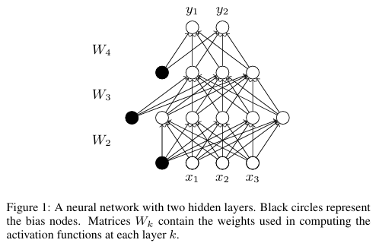
Multi Layer Neural Network
Deep learning architectures are usually constructed as multi-layer networks so that more abstract features are computed as nonlinear functions of lower-level features.

Slide 9

Neurons and Weighted Inputs
In a typical multi-layer network, each neuron receives the output of the neurons in the previous layer plus a bias signal from a special neuron that emits 1.
It then computes a weighted average of its inputs, referred to as the total input. The output of the neuron is computed by applying a nonlinear activation function to the total input value.
Output Vector of neurons
ak = $f$(W_{k} a_{k-1})
f is an activation function and Wk is the weight matrix that determines the contribution of each input signal.

Slide 10
Feed Forward and Back Propagation
In a neural network, the gradient of each weight parameter is computed through feed-forward and back-propagation procedures.
Feed-forward sequentially computes the output of the network given the input data and then calculates the error, i.e., the difference between this output and the true value of the function.
Back-propagation propagates this error back through the network and computes the contribution of each neuron to the total error.

Slide 11

Stochastic Gradient Descent (SGD)
Stochastic Gradient Descent (SGD): Instead of averaging gradients over the entire dataset (batch gradient descent), SGD computes gradients on small mini-batches for efficiency, especially on large datasets.
Learning Rate
Error Function (E)
The update rule of
stochastic gradient descent for a parameter
Mini Batch (i)

Slide 12
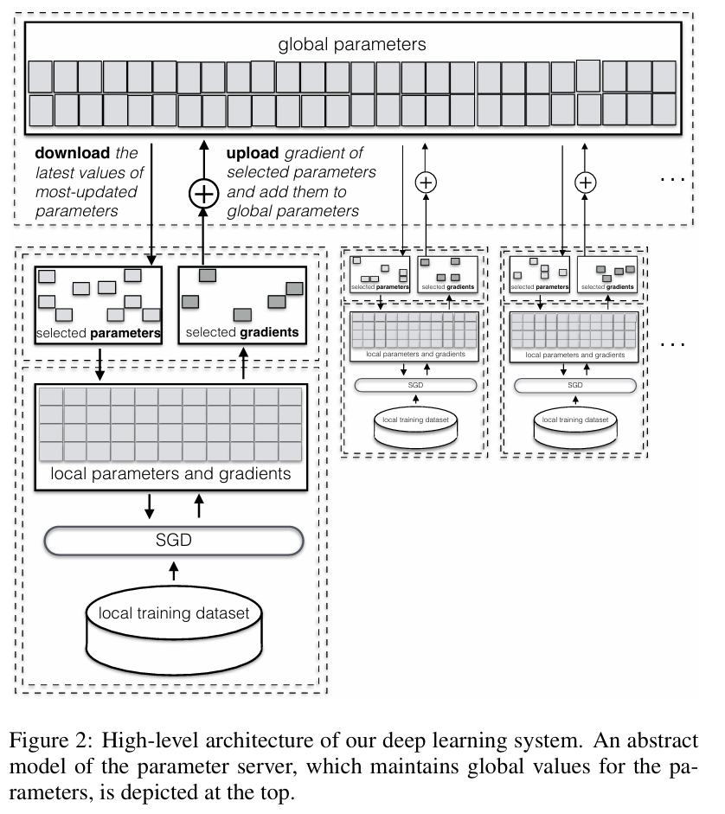
Distributed Selective SGD

Slide 13
A new approach to stochastic gradient descent
The core of the new approach is a distributed, collaborative deep learning protocol that relies upon the following observations:
updates to different parameters during gradient descent are inherently independent,
different training datasets contribute to different parameters, and
different features do not contribute equally to the objective function.
(Selective SGD or SSGD) protocol achieves comparable accuracy to conventional SGD but involves updating 1 or even 2 orders of magnitude fewer parameters in each learning iteration.

Slide 14
Selective parameter update
During SGD, some parameters contribute much more to the neural network’s objective function and thus undergo much bigger updates during a given iteration of training.
In selective SGD, the learner chooses a fraction of parameters to be updated at each iteration. This selection can be completely random, but a smart strategy is to select the parameters whose current values are farther away from their local optima, i.e., those that have a larger gradient.

Slide 15
Distributed collaborative learning
Distributed selective SGD assumes two or more participants training independently and concurrently.
After each round of local training, participants asynchronously share with each other the gradients they computed for some of the parameters.
Participants can exchange gradients directly, via a trusted central server, or even use secure multi-party computation to exchange them “obliviously,” emulating the functionality of a trusted server that hides the origin of each update.

Slide 16
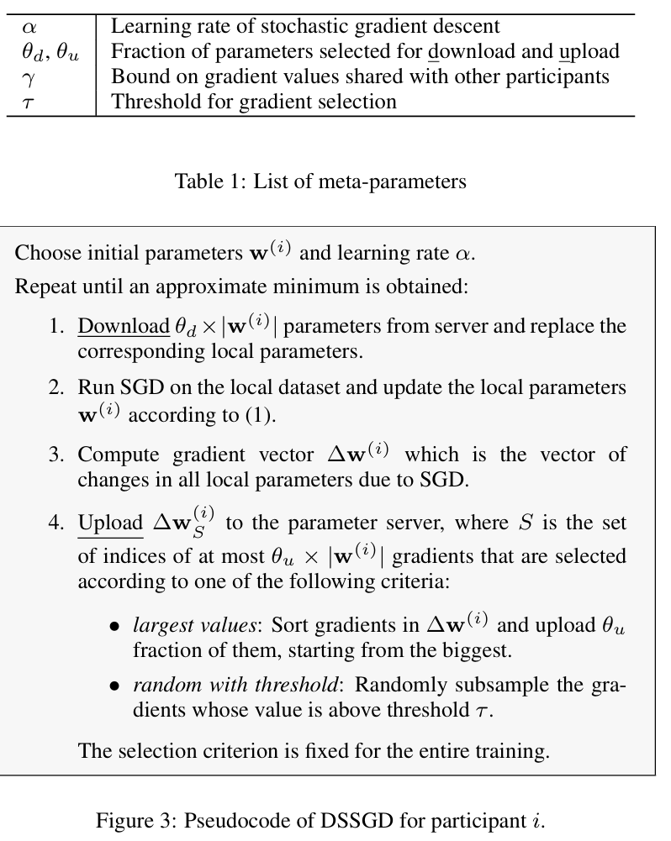
Implementation: DSSGD

Slide 17
Implementation: Local training
Each participant initializes the parameters and then runs the training on their own dataset.
We assume that each participant maintains a local vector of neural network parameters, w(i), while the parameter server maintains a global parameter vector, w(global).
Participants can initialize their local parameters either randomly or by downloading the latest values from the server.
Each participant trains the neural network using the standard SGD algorithm on their local dataset over multiple epochs. No direct coordination is needed between participants during training; they influence each other's learning indirectly through the parameter server.

Slide 18
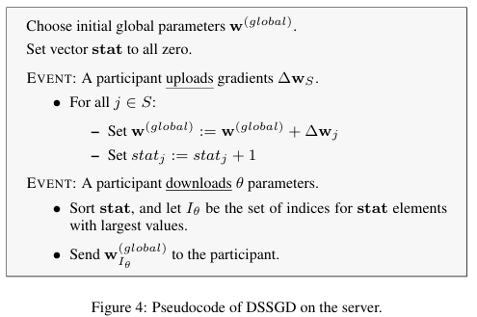
Parameter Server
The parameter server initializes the parameter vector w(global) and then handles the participants’ upload and download requests.

Slide 19
Why Distributed Selective SGD Works
SSGD achieves nearly the same accuracy as conventional SGD because of the inherent stochasticity in the learning process.
This randomness helps prevent overfitting and leads to generalization, making distributed learning as effective as centralized methods while preserving privacy.
The stochastic nature of asynchronous parameter updates in distributed learning is highly effective for training deep neural networks.

Slide 20
Parameter exchange protocol
Distributed Selective Stochastic Gradient Descent (DSSGD) does not enforce any specific schedule for participants to upload their parameters. Three evaluation scenarios are considered:
Round Robin: Participants update in a fixed sequence, downloading, training, and uploading one after another.
Random Order: Participants access the server randomly but ensure exclusive access by locking it during parameter updates.
Asynchronous: Participants do not coordinate; they update the server while others are still training, allowing overlapping updates during training.

Slide 21
Evaluation
The system is evaluated using two well-known datasets in deep learning:
MNIST: A dataset of 60,000 training and 10,000 test examples of 32x32 pixel handwritten digits.
SVHN: A dataset derived from Google Street View containing 600,000 images of house numbers (32x32 pixels, RGB). For this evaluation, 100,000 images are used for training and 10,000 for testing.
The datasets are normalized by subtracting the mean and dividing by the standard deviation. These datasets are essential benchmarks for assessing the model's performance.

Slide 22
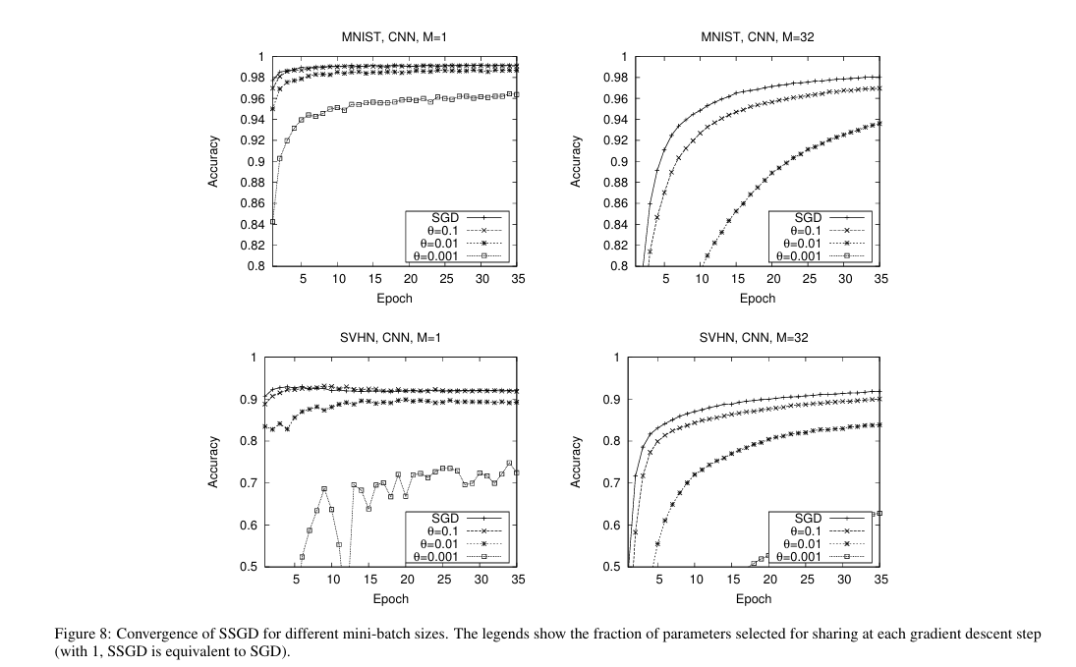
Selective SGD vs Conventional SGD
Results show that SSGD, which shares only a fraction of gradients, achieves nearly the same accuracy as conventional SGD.
The mini-batch size influences the behavior: smaller mini-batches (e.g., size 1) increase stochasticity and accelerate convergence but cause fluctuations. Larger batches (e.g., size 32) produce smoother but slower convergence.

Slide 23
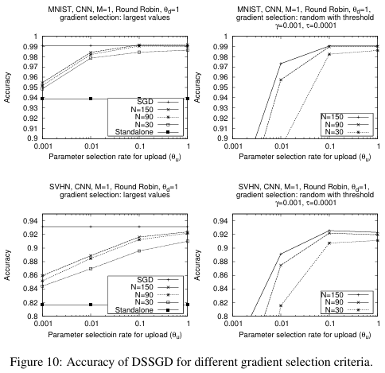
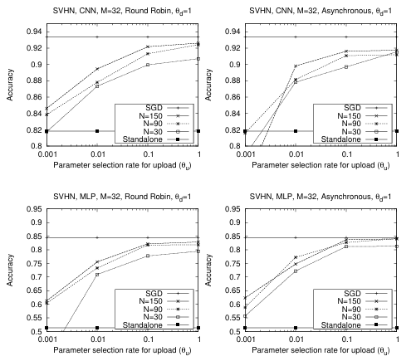
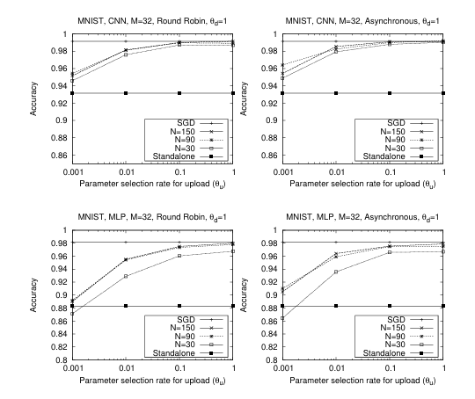
More Results
Left: DSSGD
Middle/Right: SSGD

Slide 24
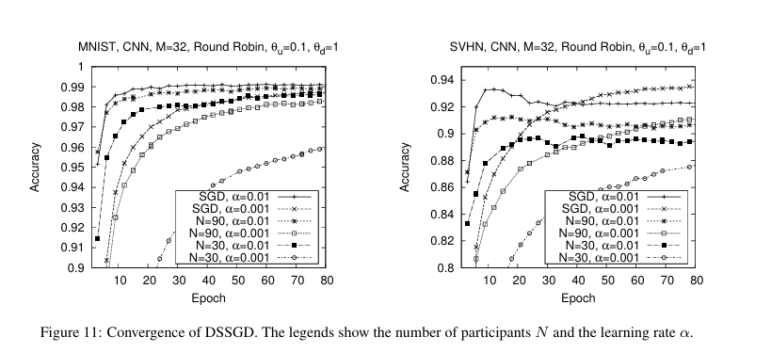
More results: Convergence of DSSGD

Slide 25
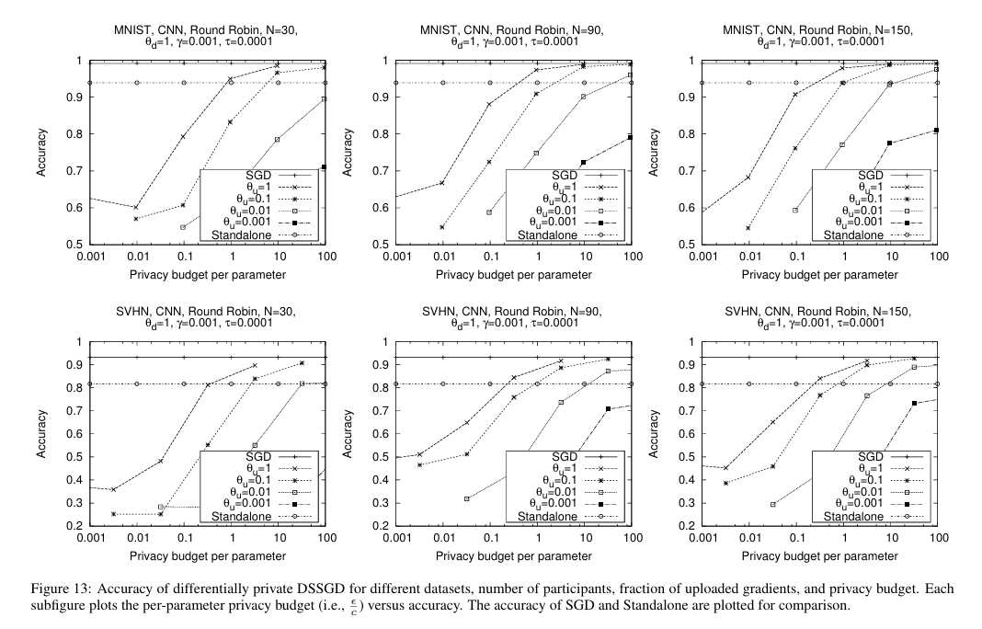
More Results: Privacy Budget

Slide 26
Back To Privacy – Problems to Solve in conventional deep learning
Training data is revealed to a third party who contributed to the data but do not have any control over it
Data owners have no control over the learning objective
The learned model is not available directly to data owners
The proposed privacy-preserving system addresses these issues by protecting training data, providing transparency, and securing model use.

Slide 27
Preventing Direct Leakage
While training the model
Participants do not reveal their training datasets to anyone, thus ensuring strong privacy of their data
The participants can also delete their data at any time
While using the model
All participants learn the model and thus can use it locally and privately, without any communication with other participants and without revealing the input data or the model’s output to anyone.

Slide 28
Conclusion
This work is the first step in bringing privacy to a machine learning approach that is revolutionizing AI. The proposed solution is a new distributed training technique, based on selective stochastic gradient descent.
The methodology works for any type of neural network and preserves privacy of participants’ training data without sacrificing the accuracy of the resulting models. Therefore, it can help bring the benefits of deep learning to domains where data owners are precluded from sharing their data by confidentiality concerns.

Slide 29

Questions?

Slide 30
Reference
Shokri, R., & Shmatikov, V. (2015). Privacy-preserving deep learning. In Proceedings of the 22nd ACM SIGSAC Conference on Computer and Communications Security (pp. 1310-1321). ACM. https://www.comp.nus.edu.sg/~reza/files/Shokri-CCS2015.pdf

